Slide 1

NHibernate Fundamentals
3 - Relationships

Slide 2
Overview
Understanding relationships
Types of collections
Cascades
Lazy loading
Inverse relationships

Slide 3
Understanding relationships
Type | Example | Characteristics
1:M | Customer.Orders | Two tables, customer and order, with a customer id on the order table
M:1 | Order.Customer | Two tables, customer and order, with an FK on Order pointing back to its parent Customer
M:M | Customer.Addresses | Two tables with a join table. Join table has two FKs, one to each table
1:1 | Customer.Person | Two tables, Customer and Person, share same PK

Slide 4
Type of collections
Type | Characteristics
List | Ordered, can have duplicates PersistentGenericList<T>
Bag | Unordered, can have duplicates PersistentGenericBag<T>
Set | Unordered, no duplicates PersistentGenericSet<T>

Slide 5
Demonstrations
1:m
M:1
Will pass on M:M and 1:1 due to time constraints

Slide 6
Cascades
Tells NHibernate how to handle child entities
Options:
None | No cascades (default)
All | Cascade saves, updates and deletes
Save-update | Cascades saves and updates
Delete | Cascade deletes
All-delete-orphan | Same as all and delete orphaned rows

Slide 7
Demo
Cascading save and delete

Slide 8
Lazy Loading
Associations are lazy loaded by default
Requires open ISession
Fetching strategies: Select, outer-join
Helps to avoid cascading N+1 query problem

Slide 9
Demo
Fetch = join
Fetch first
Fetch - horrible

Slide 10
Inverse=True?
A relational model has a FK to represent a bi-directional association
OO often uses a pointer to the other object
If you model like this, Nhibernate can generate extra updates without Inverse=True
Prevents duplicate updates of the FK and FK violations

Slide 11
Demo: Inverse=True

Slide 12
Summary
Types of relationships
Types of collections
Cascades
Lazy loading
Inverse relationships

Slide 13
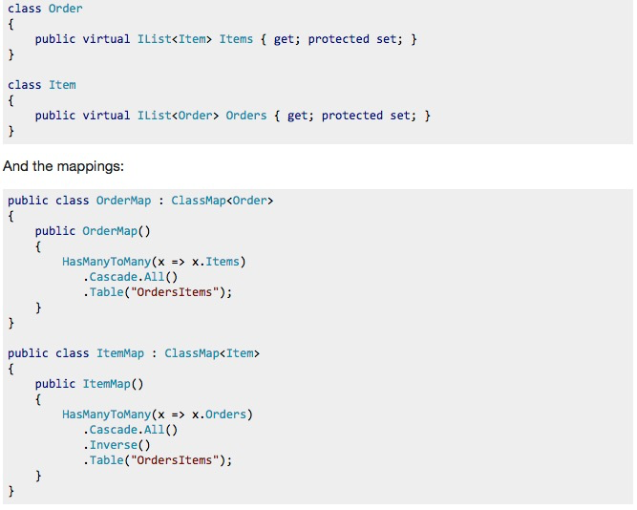
M:M

Slide 14
One-to-one associations
▪ Customer.Person
□ <one-to-one name=“Person”/>
□ Two tables, Customer and Person, share same PK
▪ Avoid <one-to-one>
□ Used for two tables that share the same primary key
▪ Use inheritance
□ Customer IS-A Person
▪ Use <many-to-one>
□ Customer HAS-A DefaultShippingAddress
□ Customers table has a standard FK to Addresses
□ <many-to-one name=“DefaultShippingAddress” />

